Slide 1
Installing Connector/J
PBC details here

Slide 2
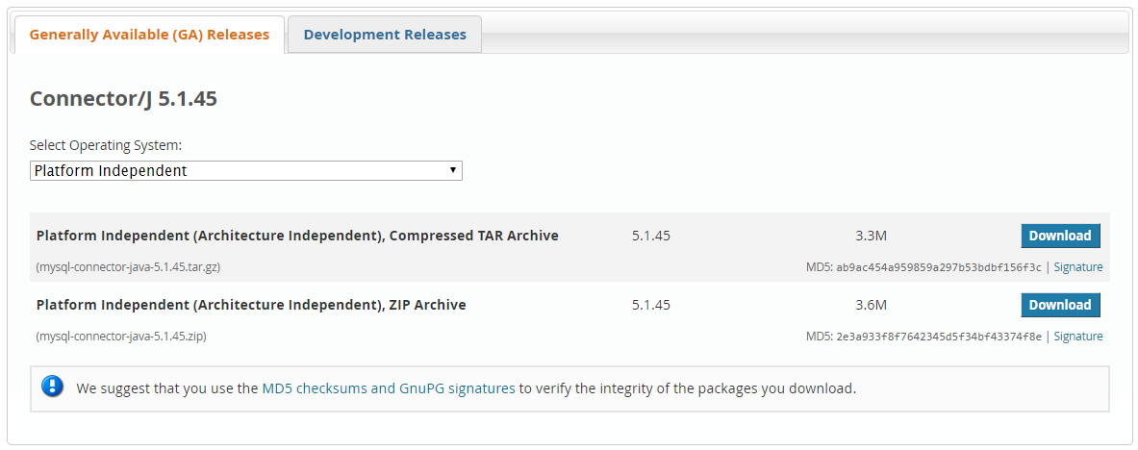

1. Download Connector/J
Go to https://dev.mysql.com/downloads/connector/j/ to download Connector/J 5.1.45.
Download the Platform Independent (Architecture Independent), ZIP Archive version.
Note: If you installed MySQL server using provided instructions, you should already have the driver in MySQL folder in C:\Program Files (x86)\MySQL\Connector.J 5.1.

Slide 3
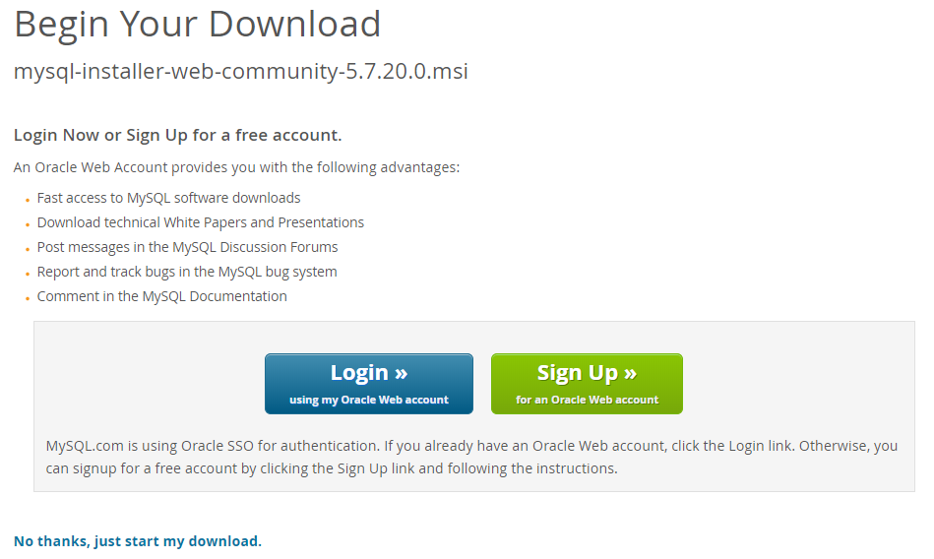
1.1. Sign Up/Login
You will be asked to Login or Sign Up for a free account.
You can choose to do that, but there is an option to proceed without logging in

Slide 4
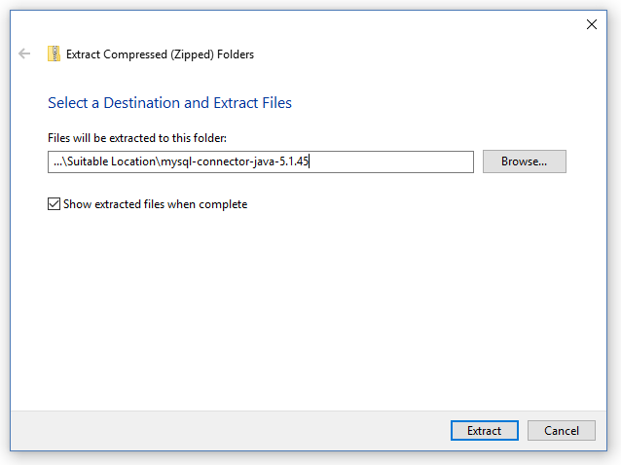
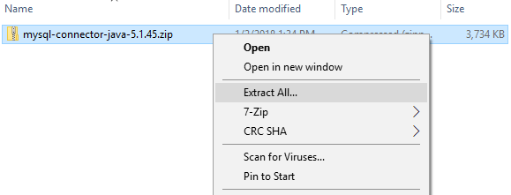
1.2. Extract the JAR
Extract the JAR archive from the zip archive to a suitable location.
Note: Be aware that in this instruction ...\Suitable location is a placeholder.

Slide 5
1.3. Add driver to CLASSPATH
Once you have extracted the distribution archive, you can install the driver by placing mysql-connector-java- 5.1.45-bin.jar in your classpath through the System Control Panel.

Slide 6
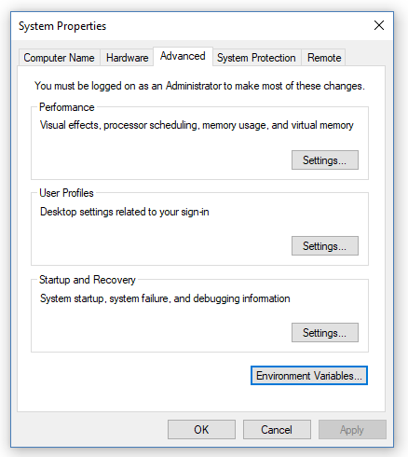
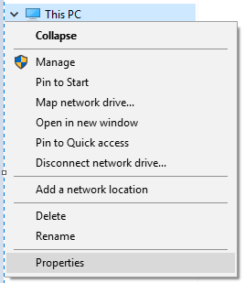
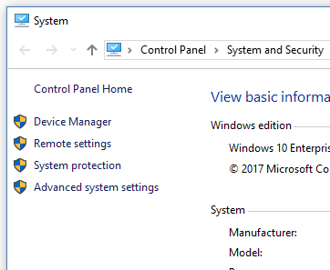

1.3.1. Locate Environmental Variables
To add a driver to your CLASSPATH, open File Explorer, click on This PC and choose Properties. In the System window choose Advanced system settings. In the System Properties window click on Environment Variables.

Slide 7
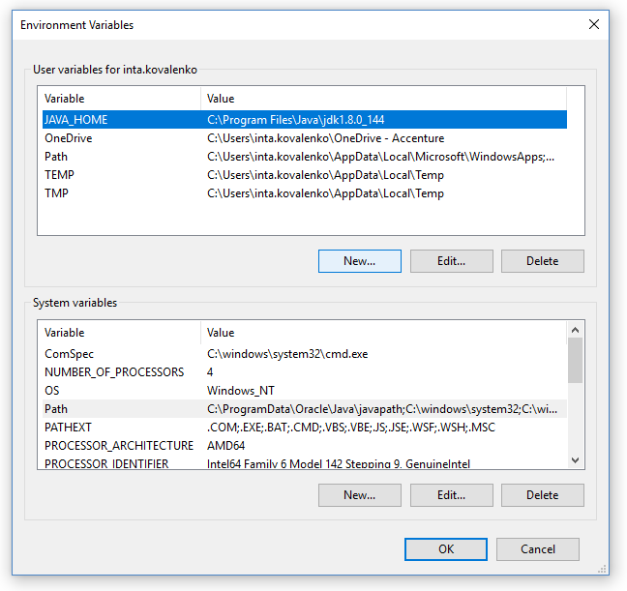
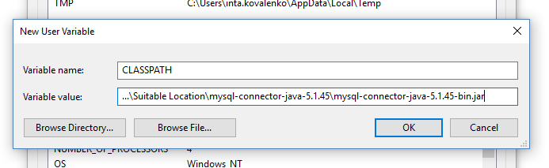
1.3.2. Create variable CLASSPATH
In User variables create New.. variable. After the variable is created, close all opened windows by clicking OK.
Variable name: CLASSPATH;
Variable value: location to connector’s JAR.

Slide 8
1.4. Check the CLASSPATH
To check whether CLASSPATH is set, execute the following command in command prompt:
echo %CLASSPATH%
If CLASSPATH is not set you will get a %CLASSPATH%, otherwise you will see the path you have set.

Slide 9
1.5. FYI
FYI: You can also search for EV by pressing Windows button on keyboard and typing in Environment Variables.
FYI: CLASSPATH environment variable is case insensitive and it can be either Classpath or classpath as well.
FYI: You can also directly specify mysql-connector-java-version-bin.jar with the command line switch -cp when starting the JVM.
FYI: To use the driver with the JDBC DriverManager, use com.mysql.jdbc.Driver as the class that implements java.sql.Driver.

